Slide 1
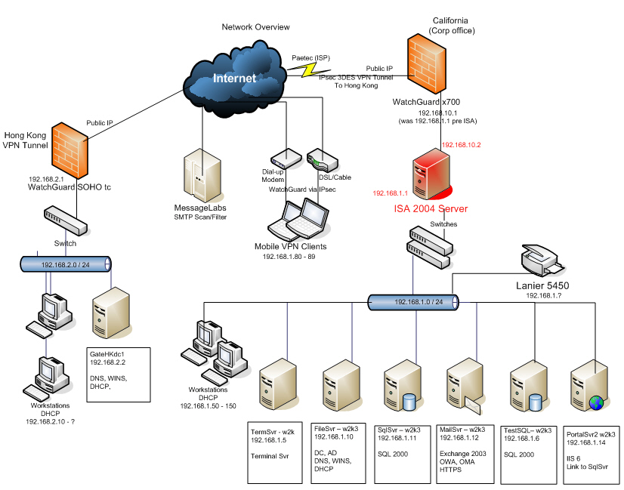
How to Build a Network
Rachel K. Bicknell
Notes:
Hello Everyone, my name is Rachel Bicknell and I'm going to explain to you how to build a network and how the Internet works.

Slide 2
What is a Network?
Local Area Network (LAN)
Connections between computers and networking devices.
Located in a “small” physical location.
Wide Area Network (WAN)
Connections between networking devices only.
Located geographically.
Could be between two sites 1 mile away, could be across states or countries
Notes:
What is a network? In general a network is a group or system of interconnected people or things.
In information technology, there are two main types of networks. A local area network, or LAN, connects computers, tablets, phones and other type of network devices together. A LAN is located in a small physical network.
A wide area network, or WAN, only connects networking devices together. WANs are located more geographically. A WAN could be two datacenters a couple of miles away, or a WAN could be two datacenters crossing countries.

Slide 3
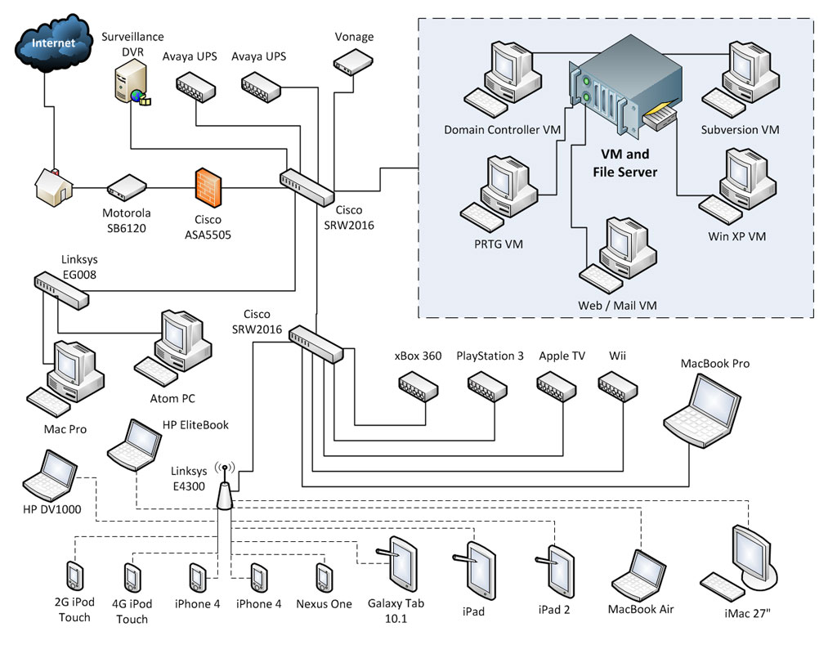
Local Area Network
Notes:
This example diagram shows you an LAN looks like. As you can see, this diagram shows a family's home network. As you can see they have laptops, servers, and tables and phones all connected to the LAN.

Slide 4
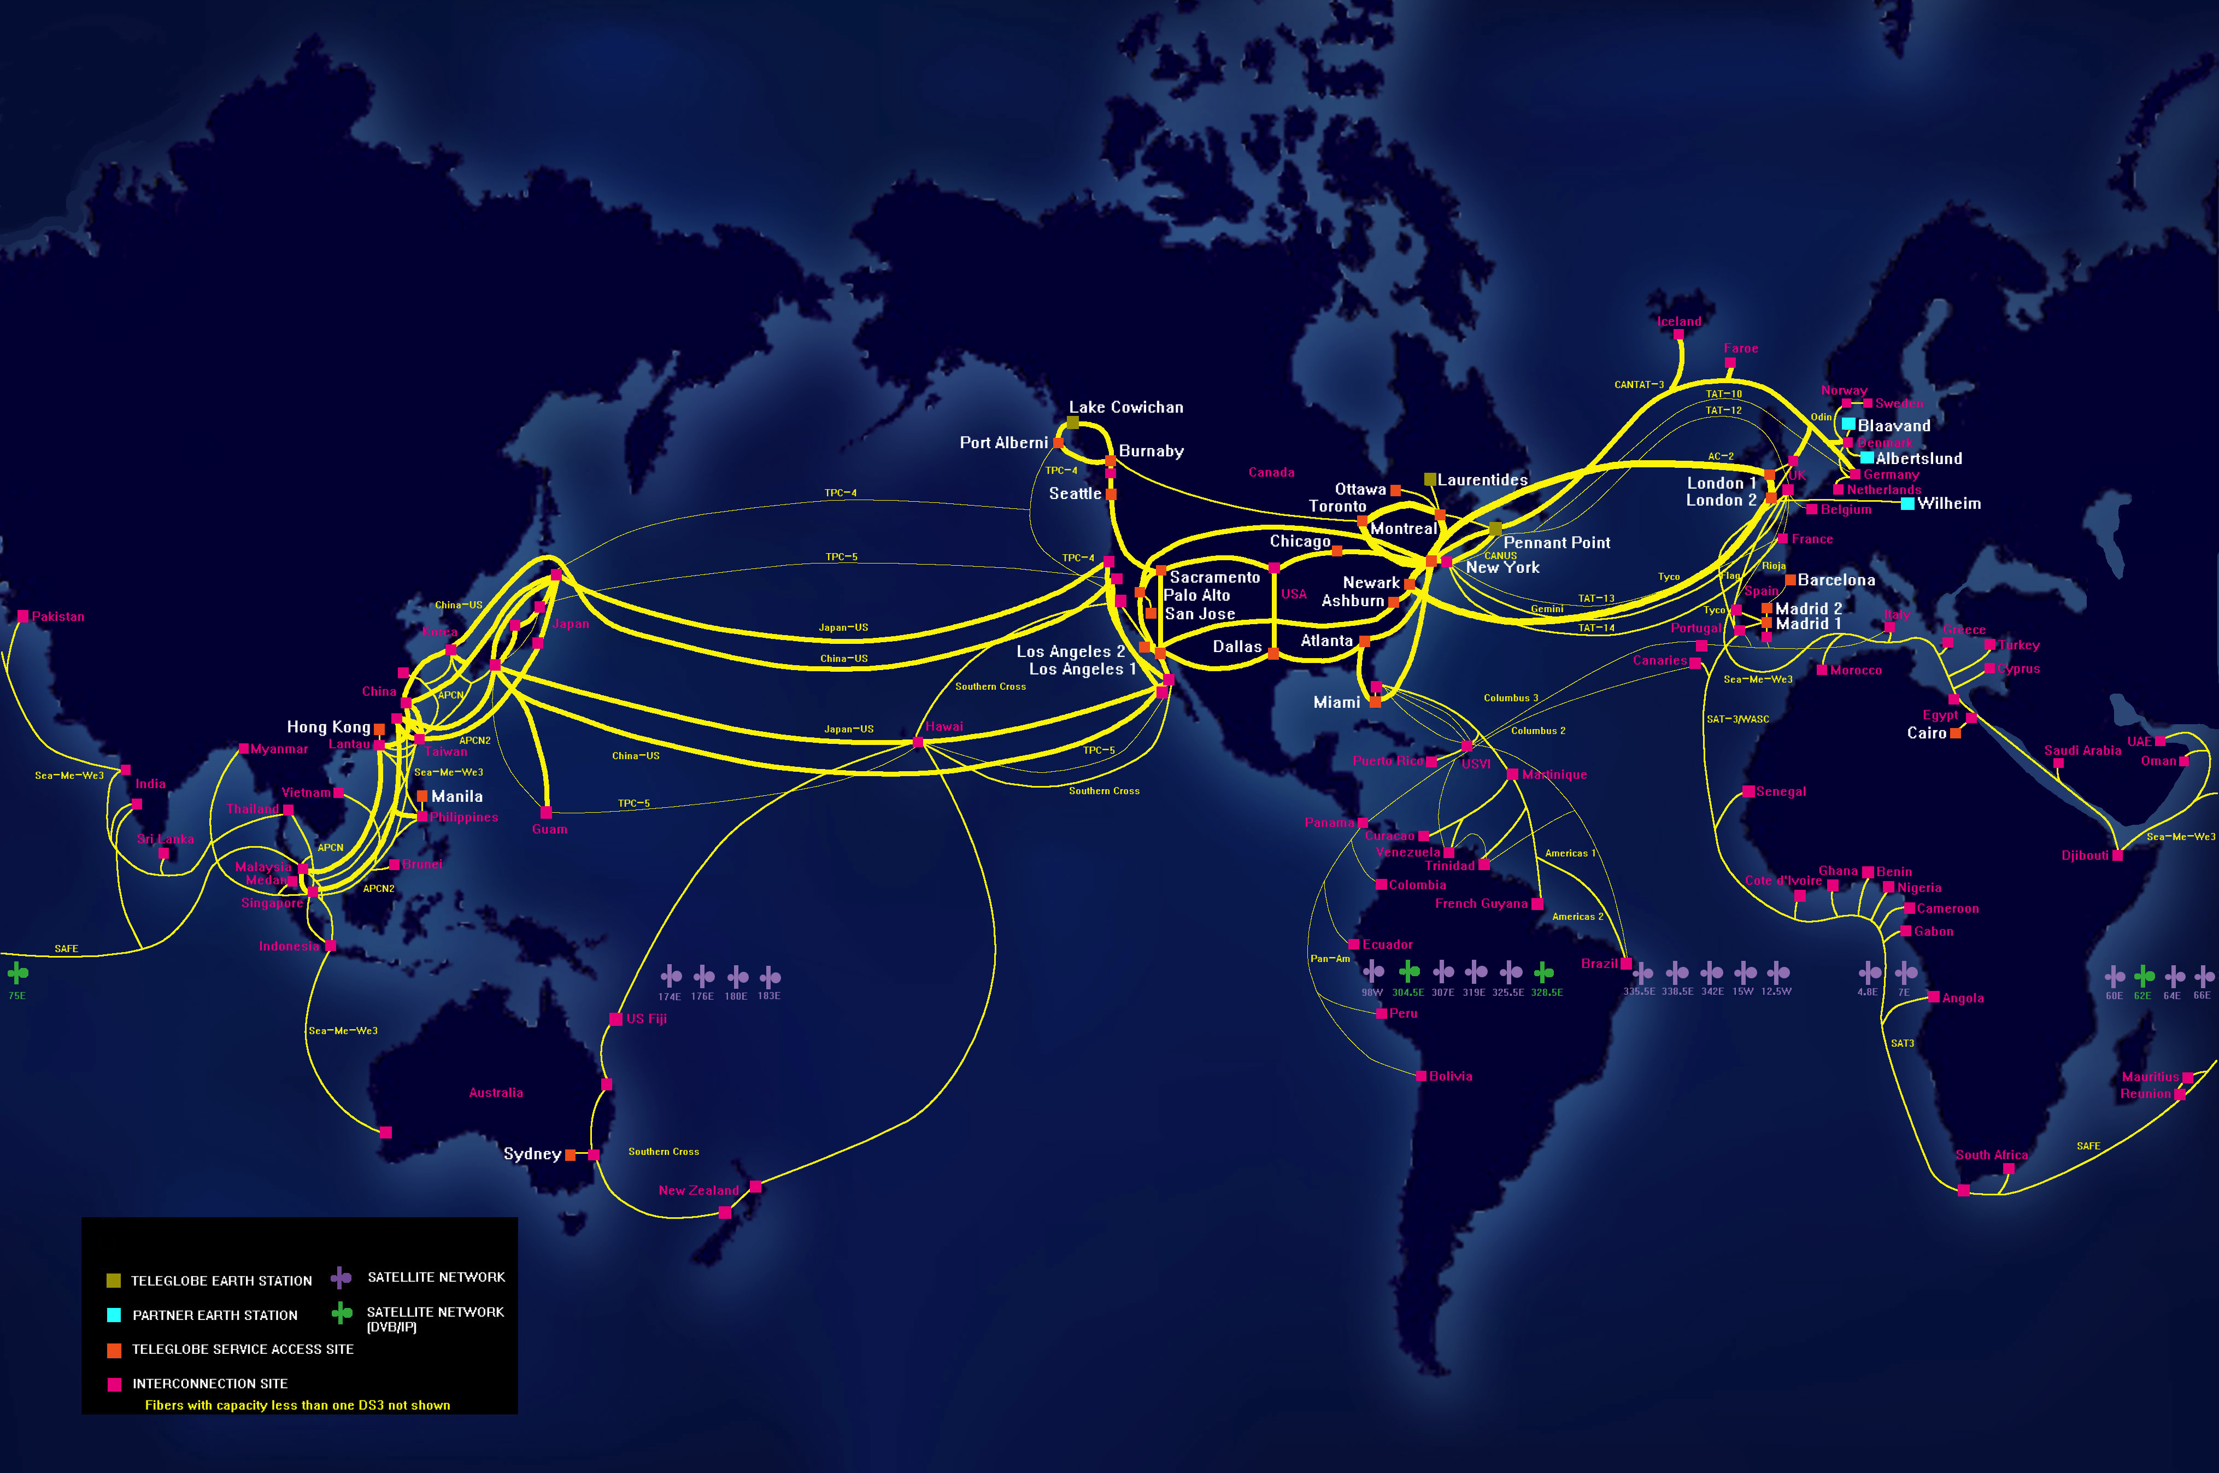
Wide Area Network
Notes:
This picture shows you what a WAN or Internetwork looks like. As you can see this WAN crosses state, countries, and even oceans.

Slide 5
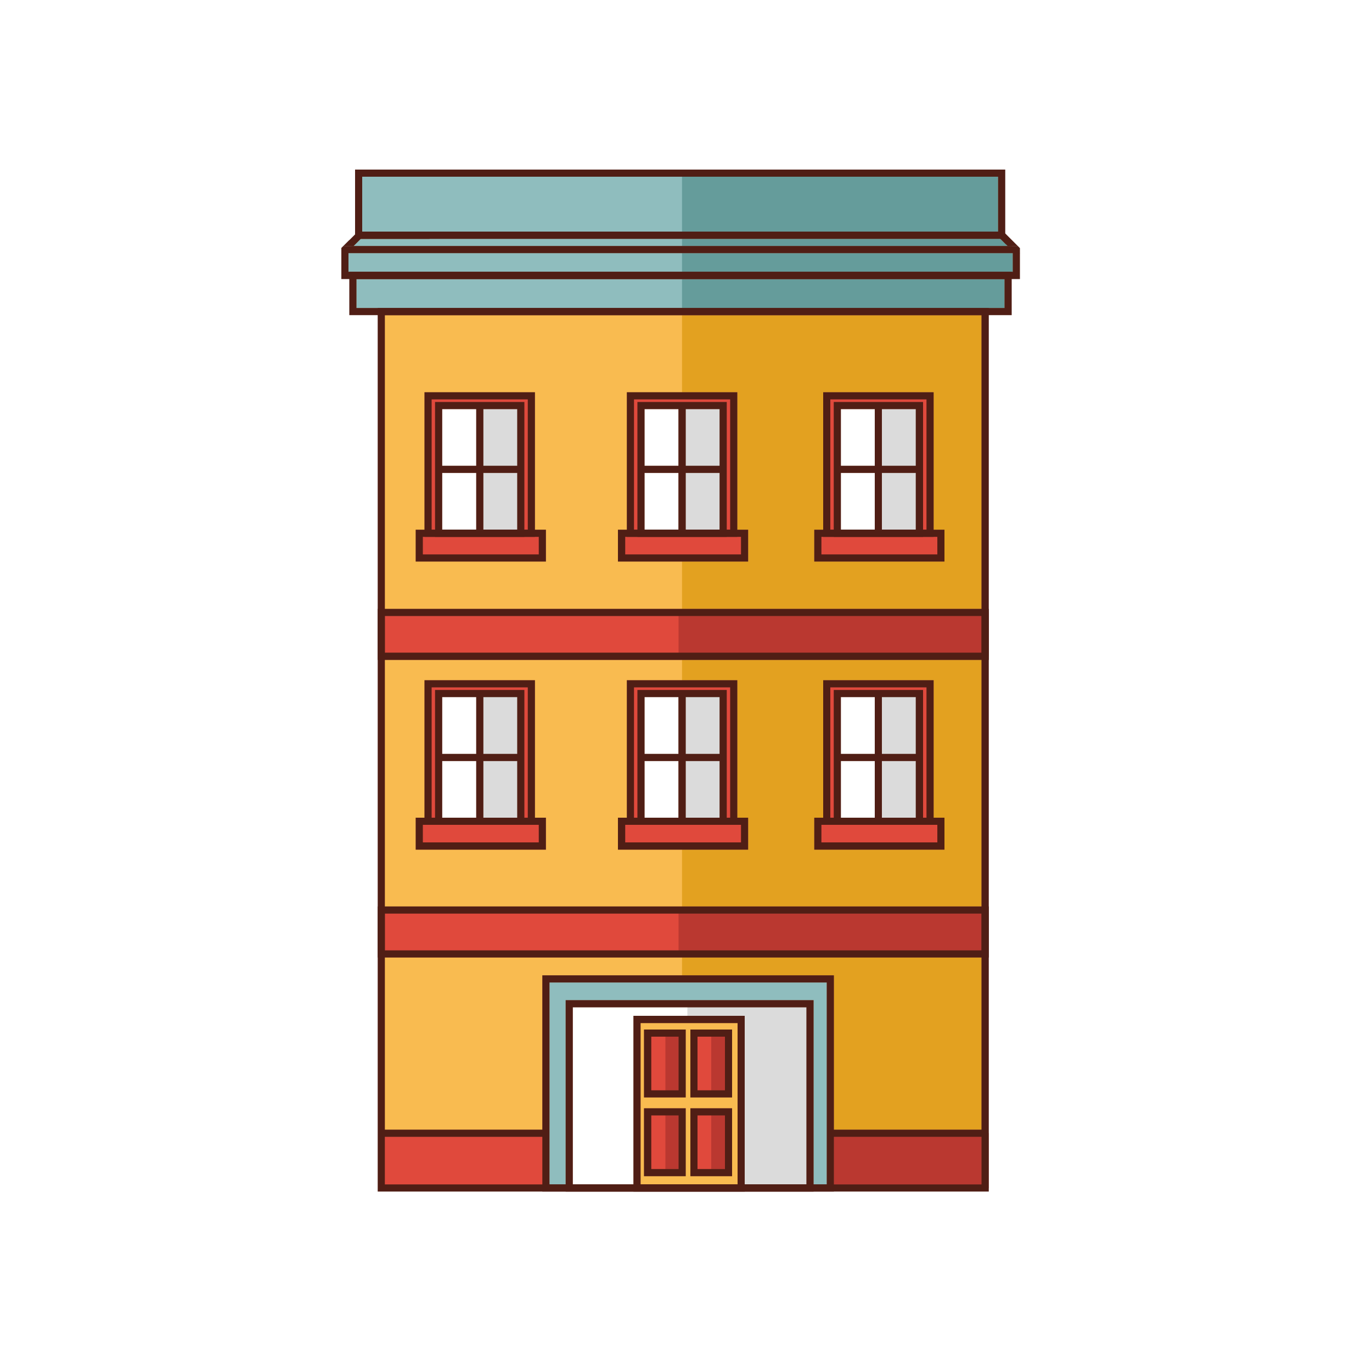
What is a Switch?
A switch serves as a controller, enabling local networked devices to talk to each other.
Think of your local post office.
Notes:
What does a network consist of? Mostly routers and switches. First, let me explain to you what a switch is.
A switch is like a controller, allowing devices to talk to each other locally.
Think of your local post office. You can send mail from Ashburn to other places in Ashburn and the mail is all sorted and sent out of the local Ashburn post office.

Slide 6
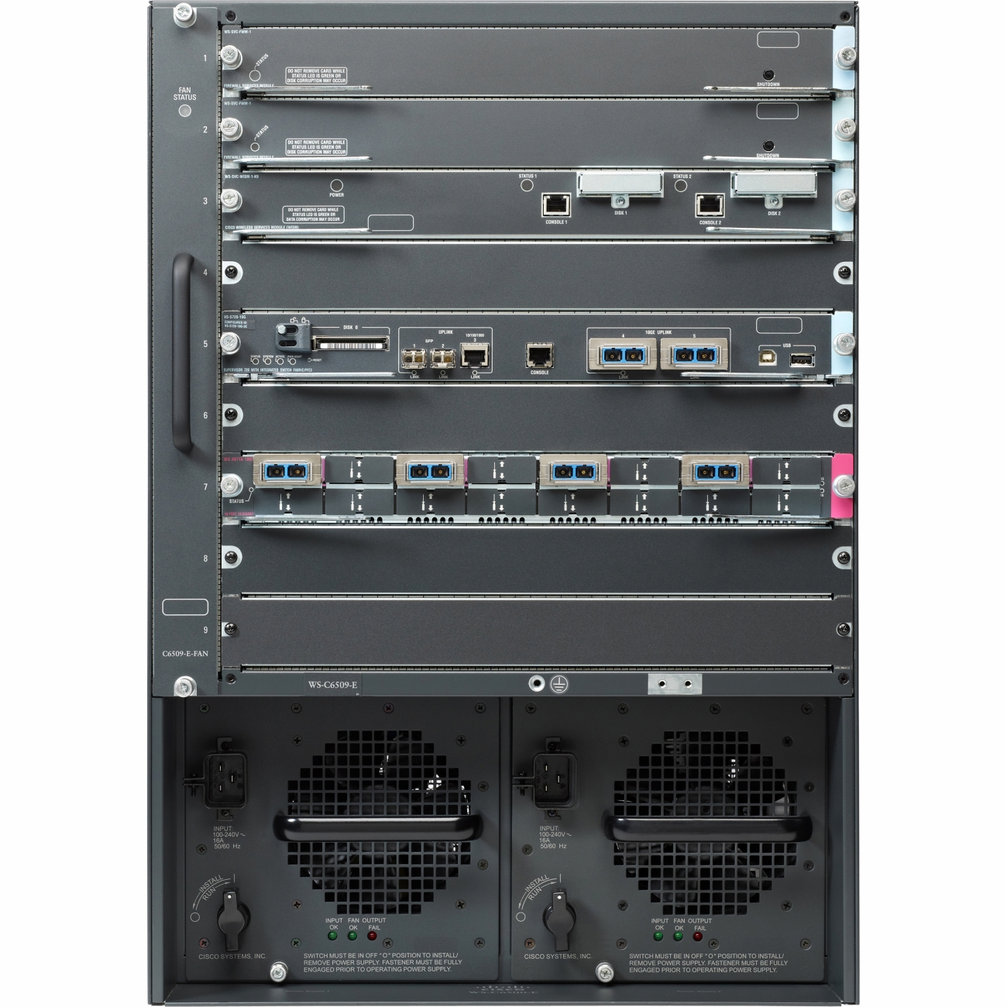
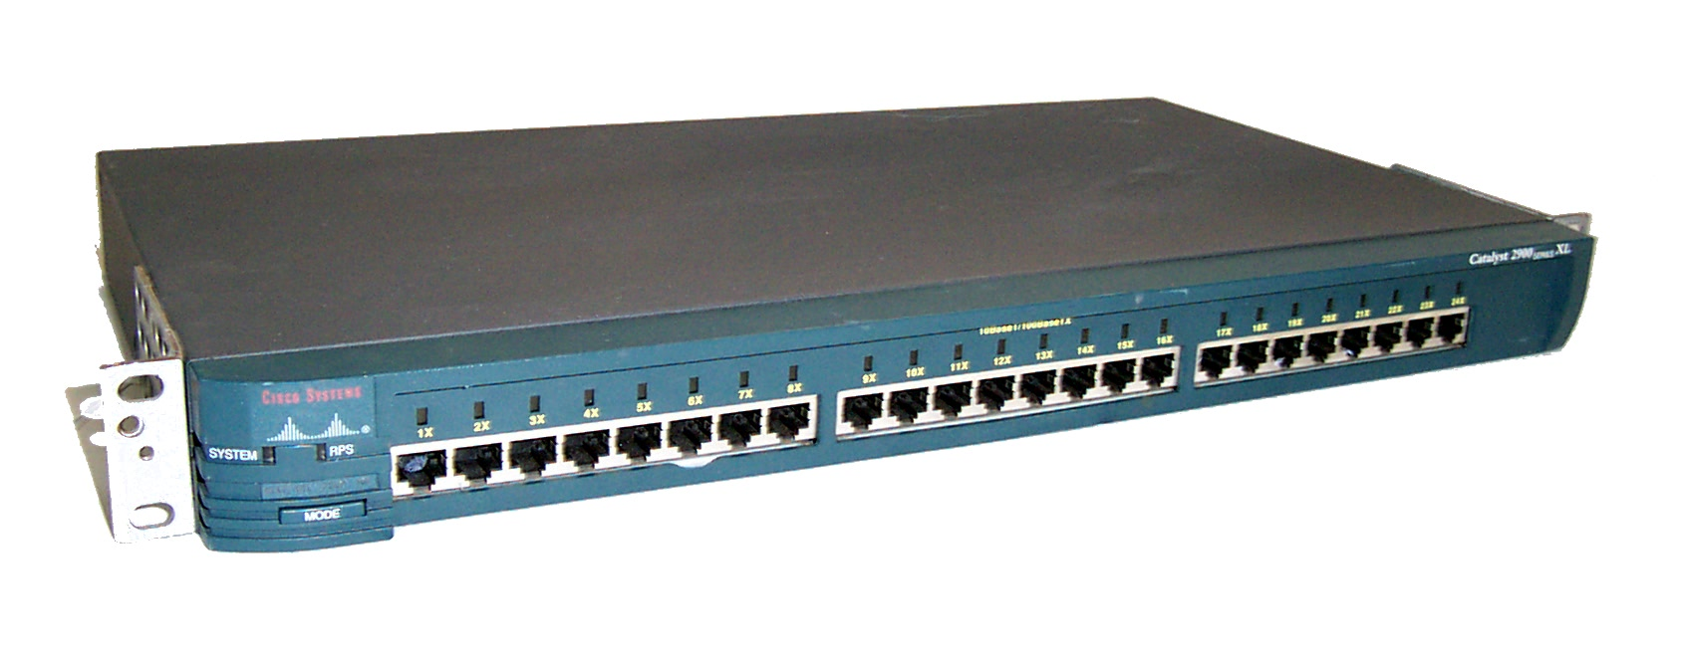
What a Switch Looks Like
Notes:
Here are two examples of what a switch can look like. They can be small like the picture on the left, or very big like the picture on the right.

Slide 7
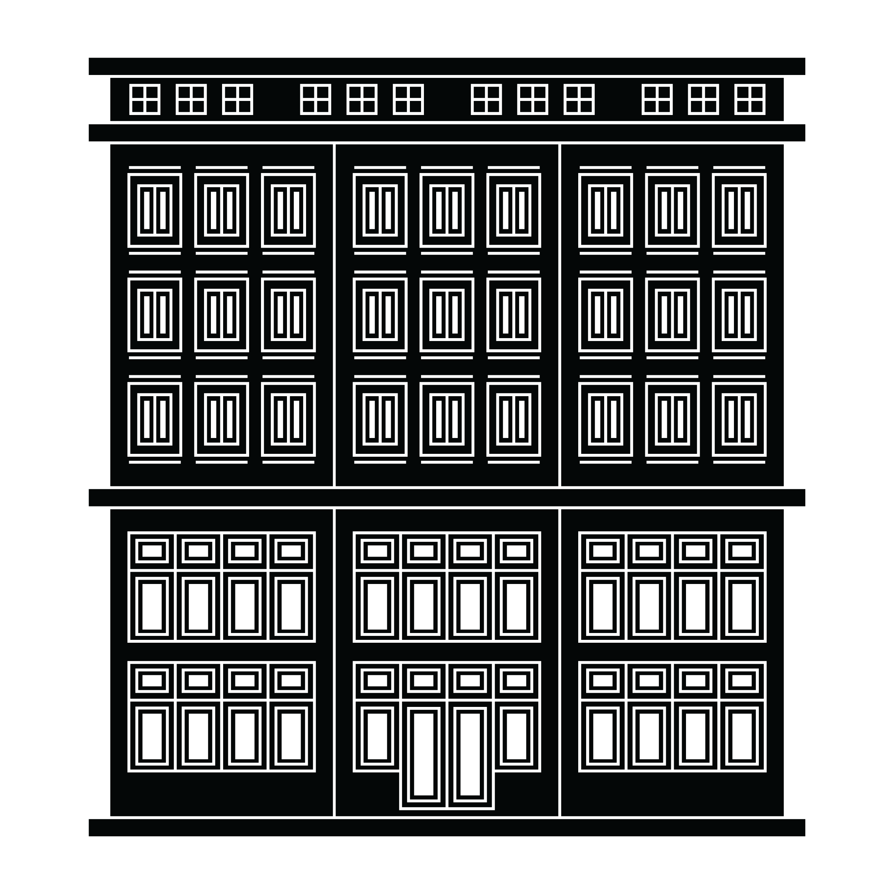
What is a Router
A router links devices to the Internet or Wide Area Network.
A router acts as a dispatcher, choosing the best path for information to travel so it's received quickly.
Think of your regional post office.
Notes:
A router is more like your regional post office. If you are sending an piece of snail mail from Ashburn and want it to go to a house in Maryland, it would first go to your local post office, then a regional post office in Virginia, then off to another regional post office in Maryland, and then back to a local post in Maryland.

Slide 8
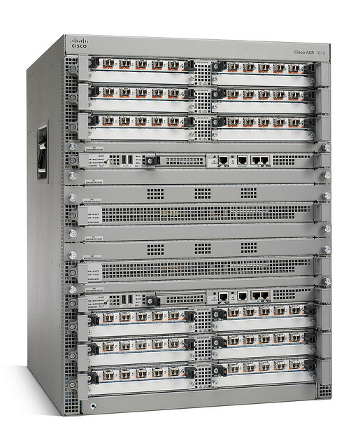
What a Router Looks Like
Notes:
Here are two examples of what a router can look like. They can be small and simple like the picture on the left, or very big and complicated like the picture on the right.

Slide 9
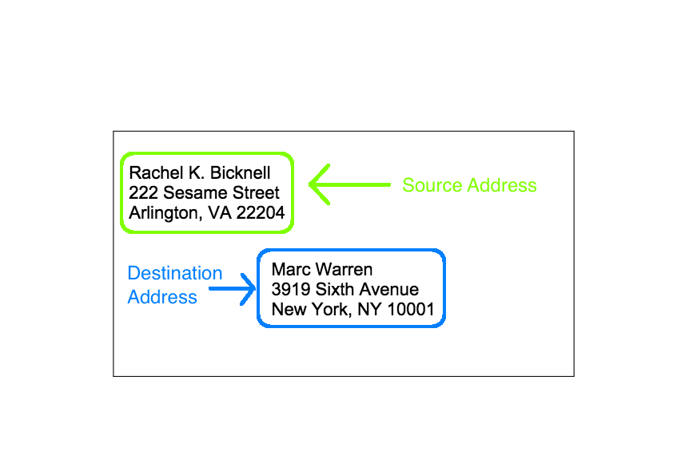
What is a Datagram?
A piece of data that carries source and destination information in a network.
Think of a piece of mail as a datagram
From == source
To == destination
Notes:
A network datagram is a piece of mail for computers. Just like a piece of mail, it has a source (where it originally comes from) and a destination (where the mail is going to.) These pieces of mail, or datagrams get sent all around a local network and maybe even on a wide area network.

Slide 10
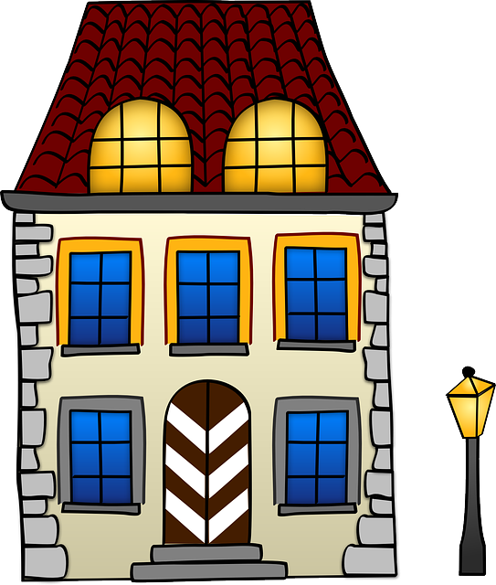
Router
Switch
Switch
Destination
Source
Notes:
In this example please pretend that the router is a cloud of routers connected together. The source address is Arlington, VA and the destination address is New York, NY. The datagram or piece of mail goes to the local post office, and then off to a few regional post offices, back to a local new york city post office, and then to the dstination address in New York City.

Slide 11
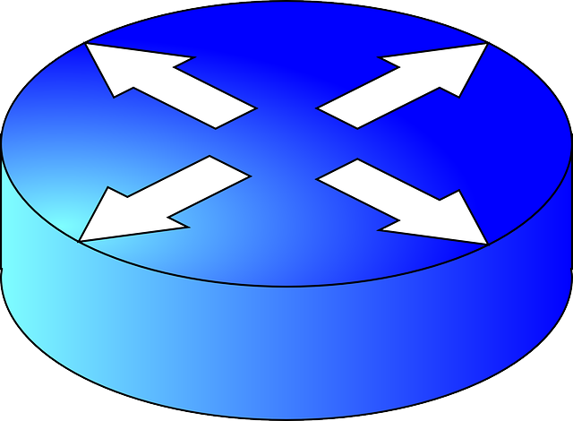
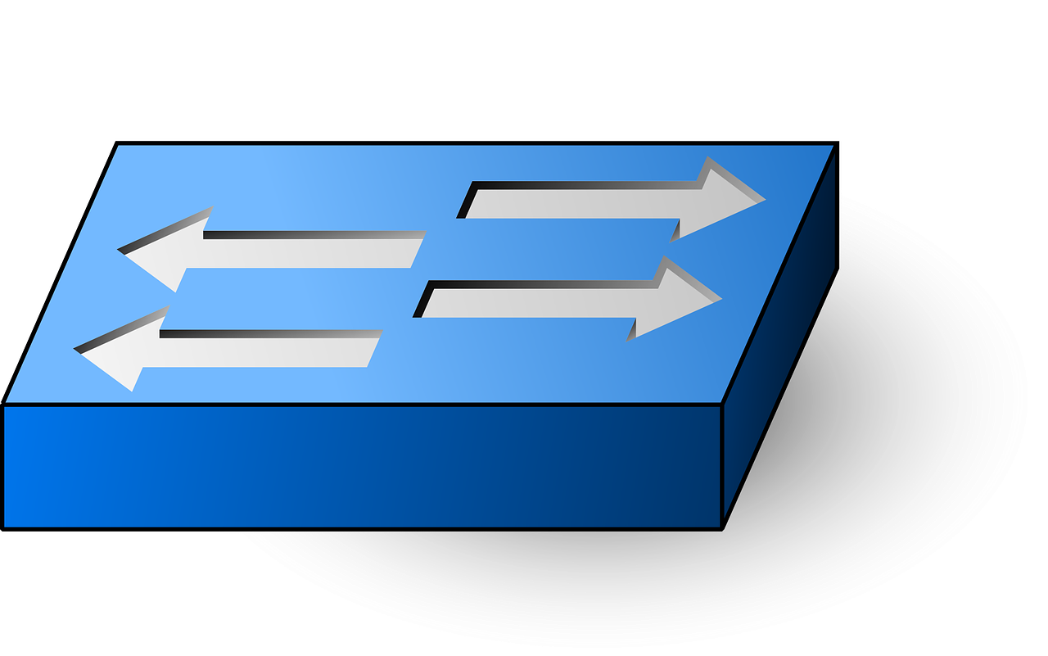
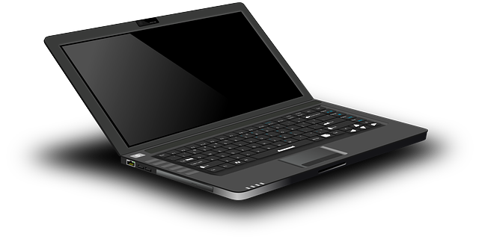
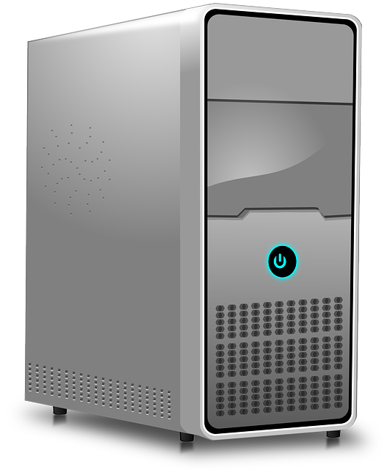
Router
Switch
Destination
Source
Source
Notes:
Same thing happens in a network. A laptop wants to connect to another laptop, so that stays in the local area network. However, if that laptop wants to connect with the server, it has go to to a switch, a router, and then another switch to get to the server.

Slide 12
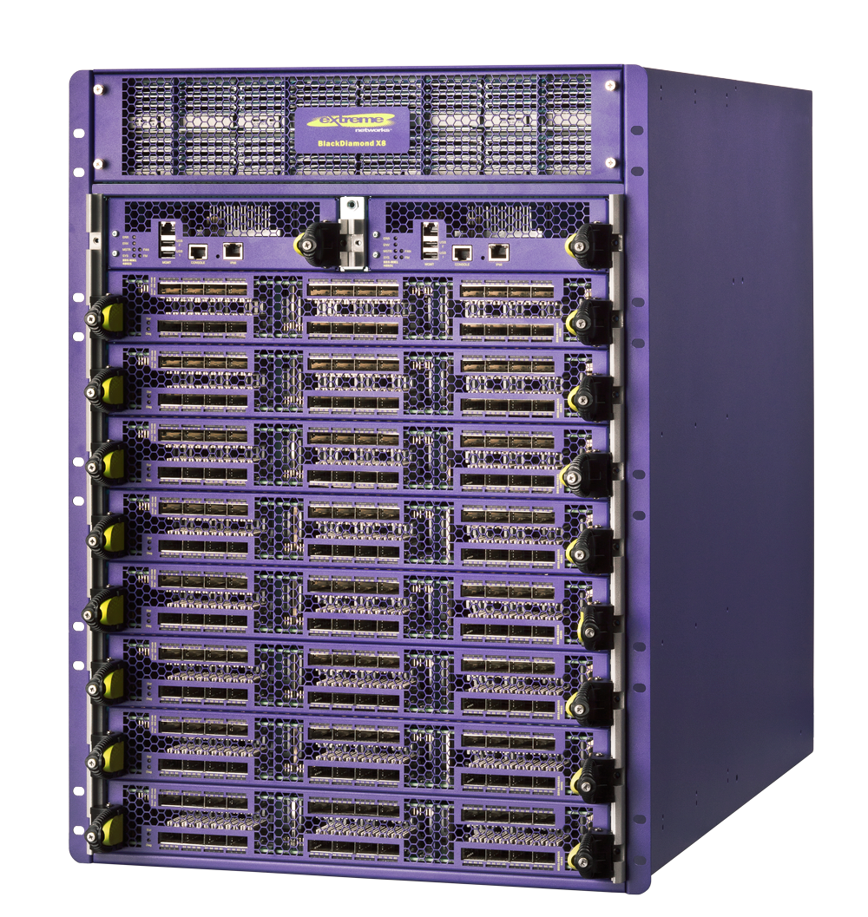
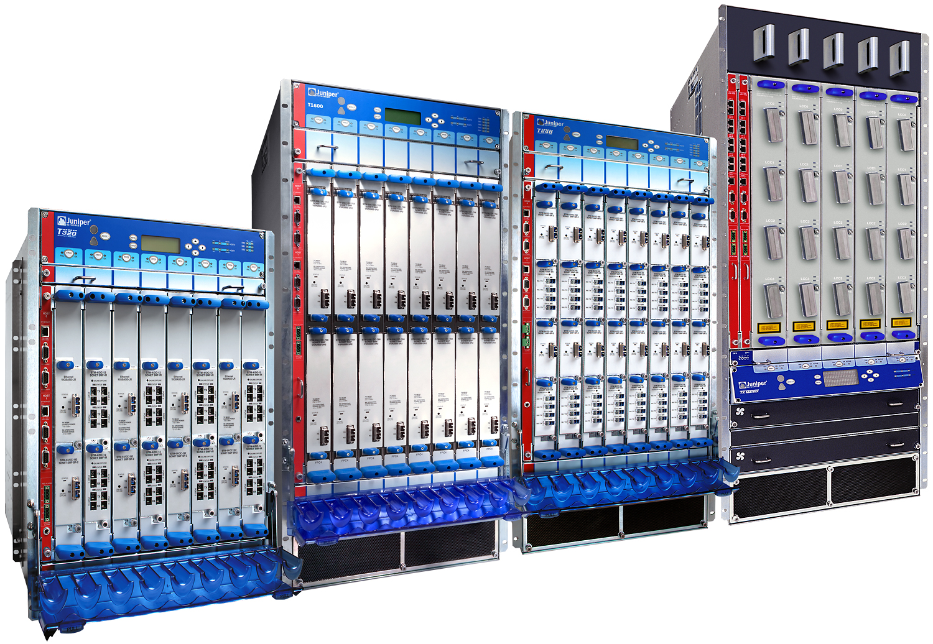
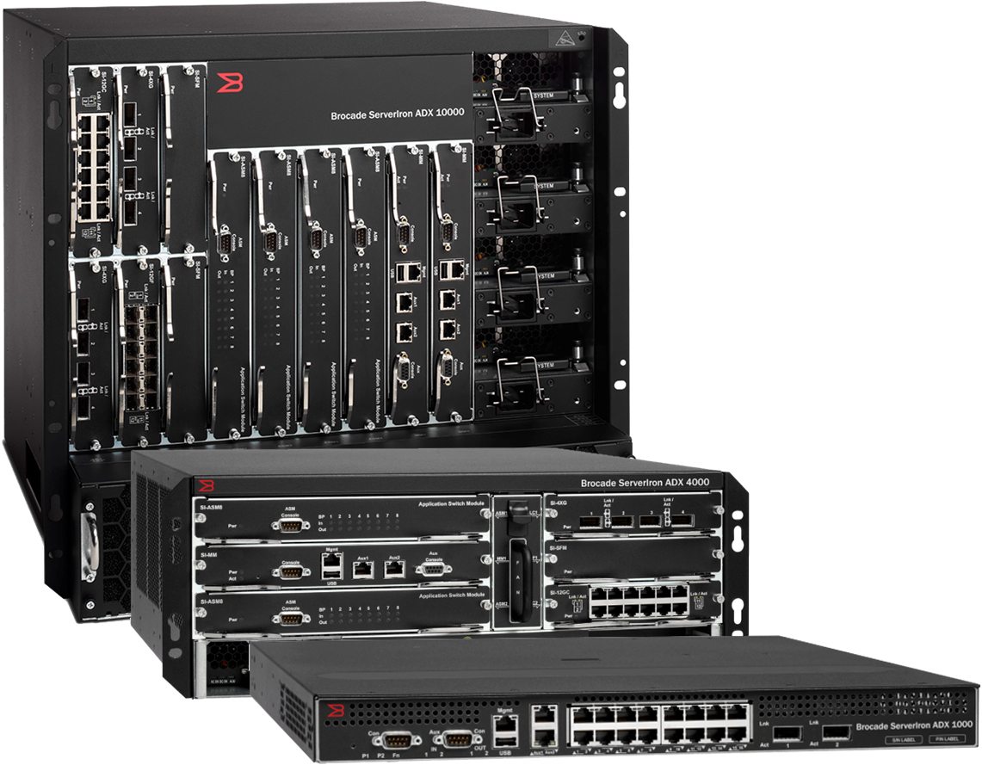
Multiple Vendors for Your Real Network
Extreme
Juniper
Brocade
Cisco
Notes:
There are multiple vendors one can use to create a network. Some of the most popular are Cisco, Juniper, Brocade and Extreme.

Slide 13
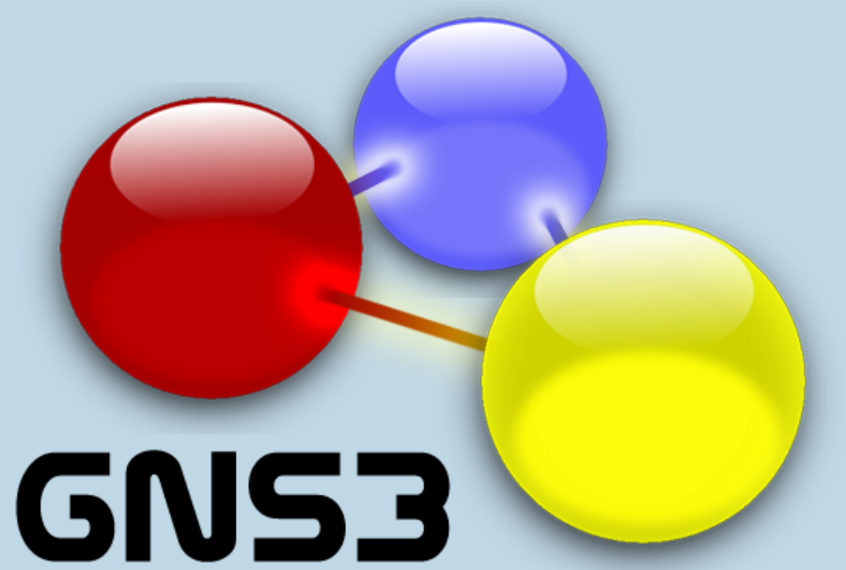
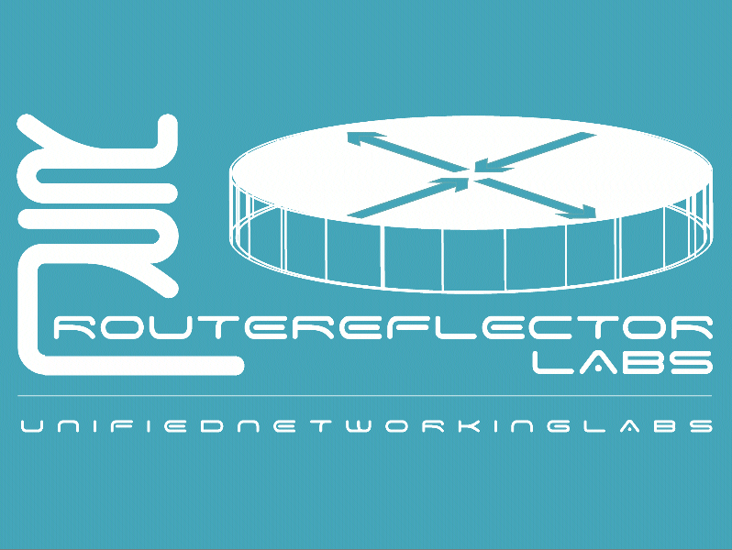
Creating a Simulated Network
GNS3 Graphical Network Simulator
Unified Networking Labs
Notes:
You can also create simulated networks on your own computer. There are two popular ones you can use – either GNS3 or Unified Networking Labs.

Slide 14
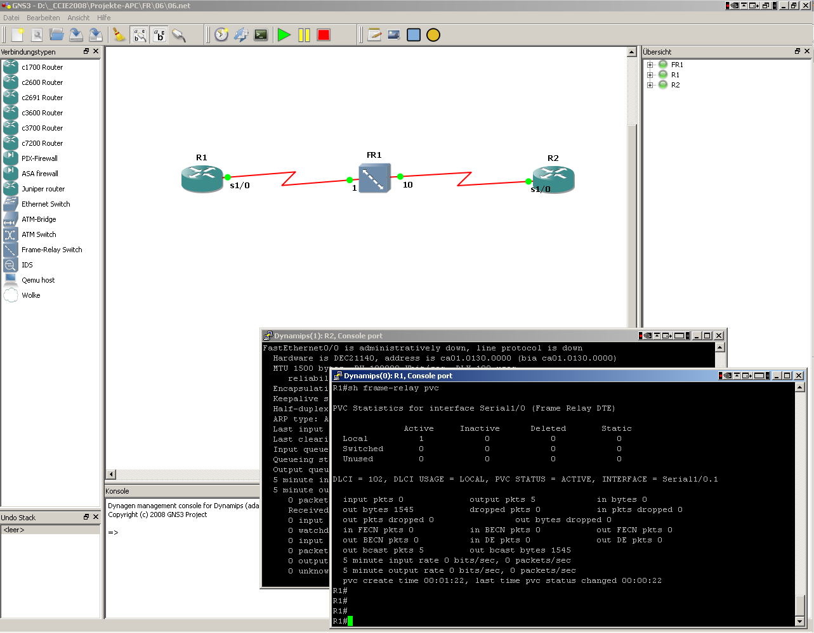
Notes:
This screen shot shows someone using GNS3 to simulate a network. It gives a nice graphical user interface to see routers, switches, and then it's easy to log into those simulated devices.
GNS3 is the most mature software of the two.

Slide 15
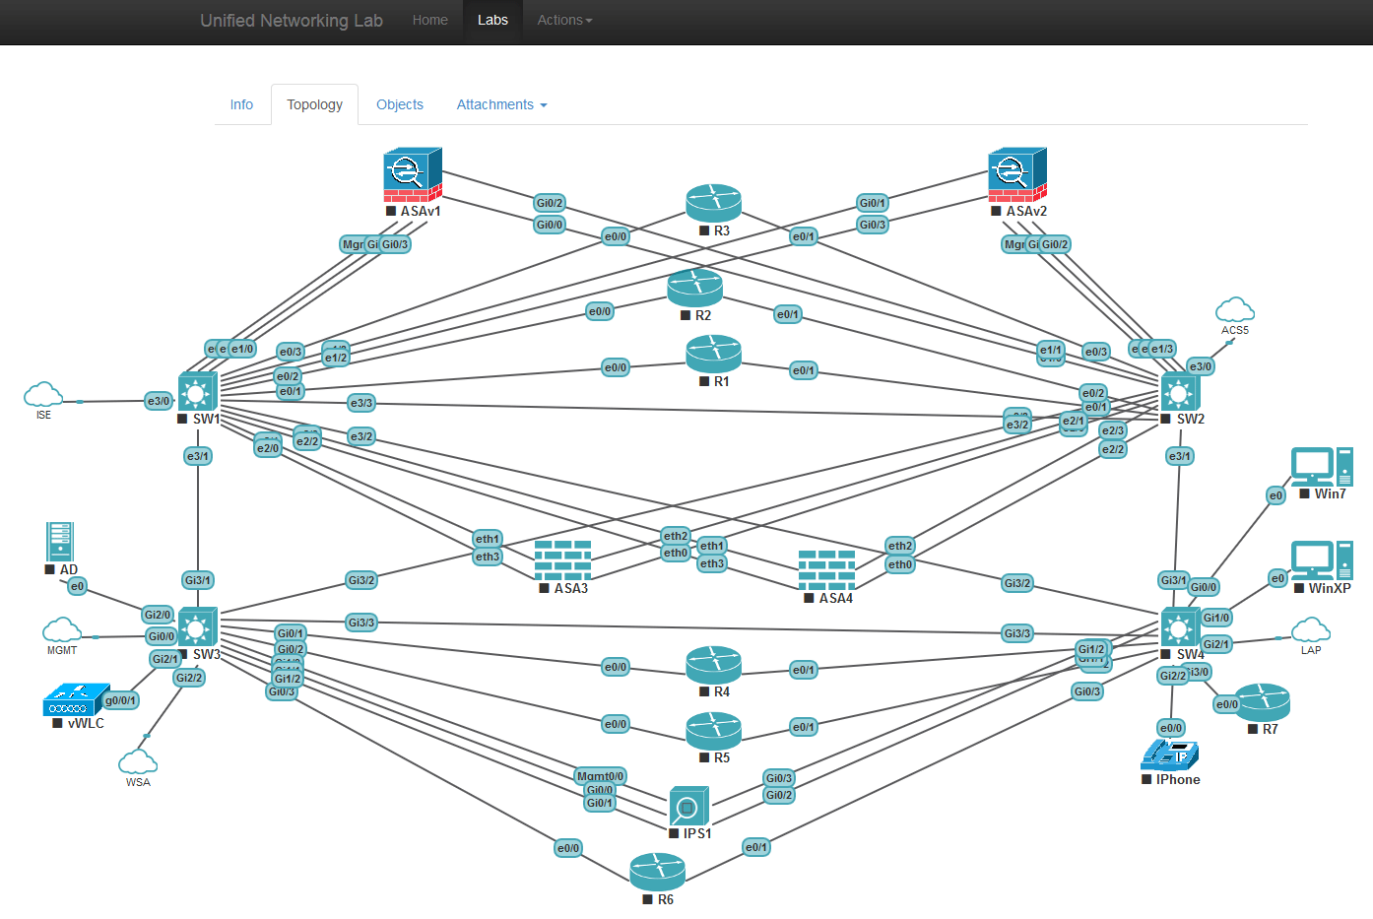
Notes:
This screen shot shows someone using Unified Networking Lab to simulate a different network. It gives a nice graphical user interface to see routers, switches, firewalls and other networking devices.

